Slide 1
Performance analysis of Lingvo

Slide 2
Tools used
For profiling, a high-level profiler (Tensorflow Profiler) is used.
Profilers running at a lower level (nvprof), cannot provide relation between a kernel and the corresponding operation.
Eg.

Slide 3
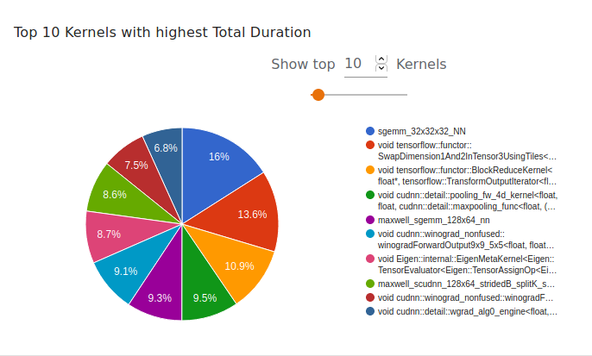
Tools used
Tensorboard presents the collected results in a easy-to-understand form.

Slide 4
What was measured
GPU load and memory utilization
Expensive operations and kernels
Profiling done for 200 minibatches/steps

Slide 5
Variations tested
Gpipe/ no Gpipe
No. of splits/partitions (only applicable if Gpipe used)
No. of GPUs

Slide 6


CPU, 1 split, no GPipe
GPU characteristics
GPU Stats (Personal laptop)
Time: ~60 sec (on AWS)
Why is GPU Memory being used? (Doubt)

Slide 7
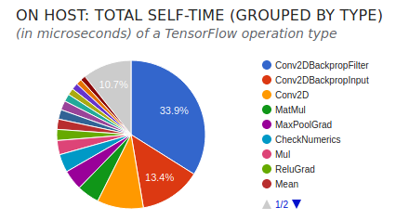
CPU, 1 split, no GPipe
Operation distribution

Slide 8
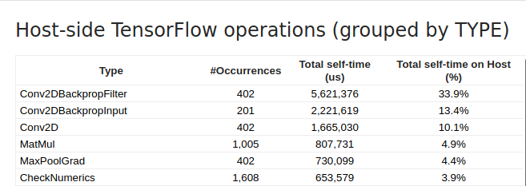
CPU, 1 split, no GPipe
Expensive operations

Slide 9
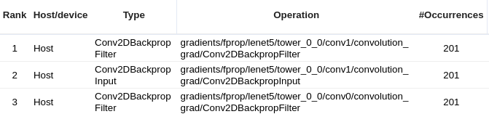
CPU, 1 split, no GPipe
TfProf provides more fine-grained division of operations
Notice that it distinguishes between Conv0 and Conv1’s BackPropFilter

Slide 10

CPU, 1 split, GPipe
GPU Stats
Time ~ 80 sec

Slide 11
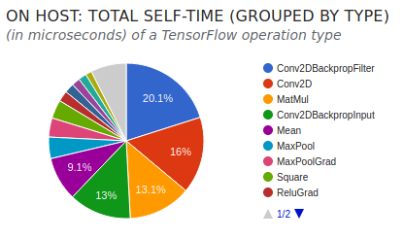
CPU, 1 split, GPipe
Operation distribution

Slide 12
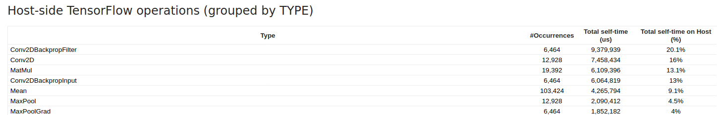
CPU, 1 split, GPipe
Notice that the no of occurrences of the operations has increased compared to non-gpipe.
This is because it is being applied on each micro batch, rather than just a minibatch
Tot. Time > non-gpipe version

Slide 13
CPU, 2 splits, GPipe
GPU Stats
Time ~70 sec

Slide 14
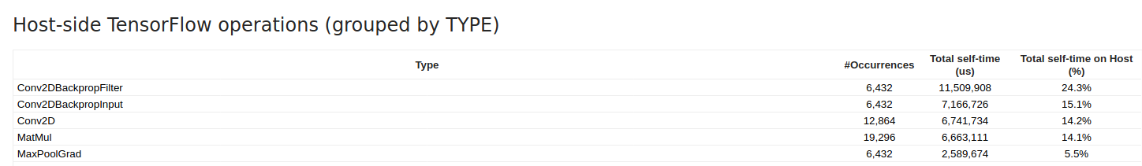
CPU, 2 splits, GPipe
Division of ops
Tot time increases even more

Slide 15

1 GPU, 1 split, no GPipe
GPU Stats
Time ~ 60 sec

Slide 16
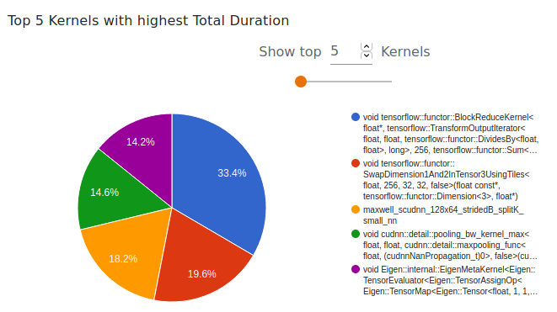
1 split, 1 GPU, no GPipe
Kernel Stats

Slide 17
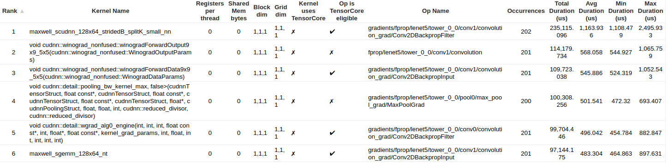
1 split, 1 GPU, no GPipe
Kernel Stats
Possible optimization?

Slide 18
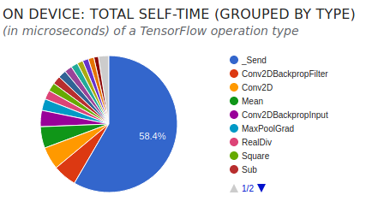
1 split, 1 GPU, no GPipe
Operation Stats

Slide 19
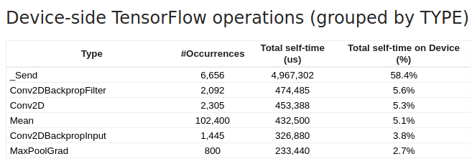
1 GPU, 1 split, no GPipe
Operation Stats

Slide 20

1 GPU, 1 split, GPipe
GPU Stats
Time ~80 sec

Slide 21
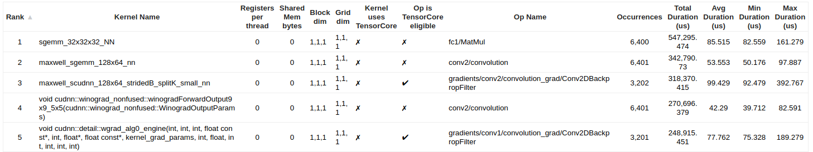
1 GPU, 1 split, GPipe
Kernel Stats

Slide 22
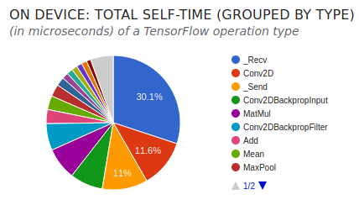
1 GPU, 1 split, GPipe
Operation Stats

Slide 23

1 GPU, 2 splits, GPipe
GPU Stats
Time ~85 sec

Slide 24
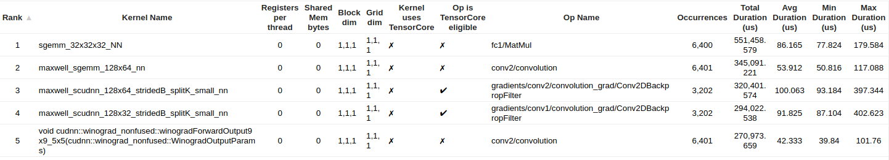
1 GPU, 2 splits, GPipe
Kernel Stats

Slide 25
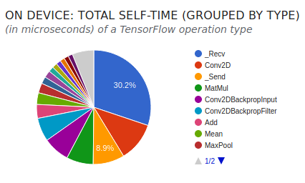
1 GPU, 2 splits, GPipe
Operation Stats

Slide 26

2 GPU, 1 split, no gpipe
GPU Stats
Time ~60 sec
Not possible to assign a split to multiple gpus

Slide 27

2 GPU, 1 split, GPipe
GPU Stats
Time ~85 sec
A split cannot run on multiple GPUs
Irrespective of whether Gpipe is used or not

Slide 28

2 GPU, 2 split,GPipe
GPU Stats
Time ~85 sec
Now both GPUs being utilized. Imbalance may be due
to imperfect partitioning

Slide 29
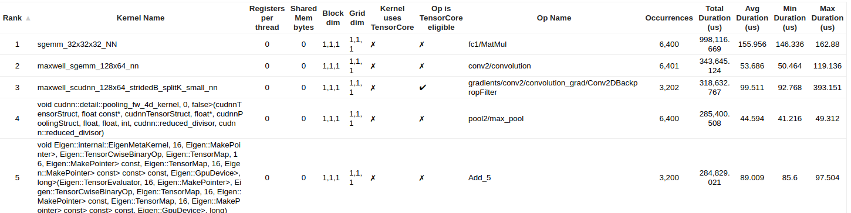
2 GPU, 2 split, GPipe
Kernel Stats

Slide 30
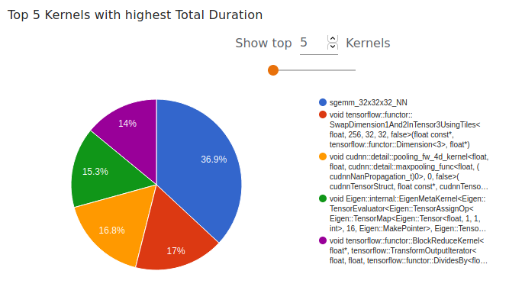
2 GPU, 2 split, GPipe
Kernel Stats

Slide 31
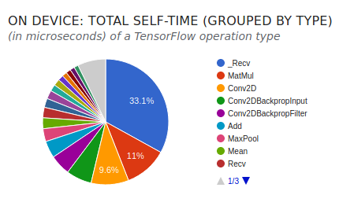
2 GPU, 2 split, GPipe
Operation Stats

Slide 32
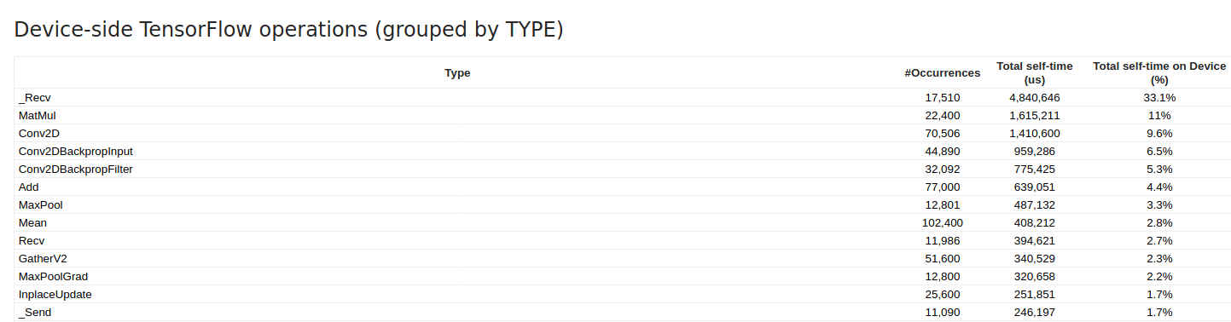
2 GPU, 2 split, GPipe
Operation Stats

